Slide 1

SOCIAL CONFLICTS DYNAMICS AND EFFECTS ON LIVELIHOODS IN THE PASTORAL AND AGRO-PASTORAL COMMUNITIES OF KARAMOJA CLUSTER
Derick Ansyijar Kuule
PhD Student
Department of Environmental Management, Makerere University
Supervisors: Anthony Egeru, Alice Turinawe & Barbara Schumann

Slide 2




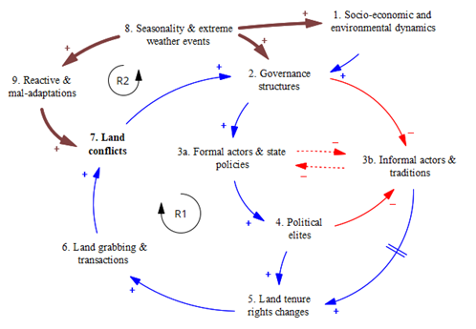



Paper1: Multi-dimensionality and interconnectedness of social conflicts in the Karamoja sub-region in northeastern Uganda
Methods and materials
Mixed methods approach
Female and male-separated focus
group discussions involving
rural participatory approaches
Findings
Five themes revealed social conflict types
Seasonal shifts in conflicts revealed
Interlinkages in conflict types and drivers were
revealed
Conclusion: Community perspectives unraveled better representation and insights into social conflict patterns. Seasonal dynamics and interconnected conflict drivers are worthy considerations when designing conflict interventions in the Karamoja sub-region.

Slide 3
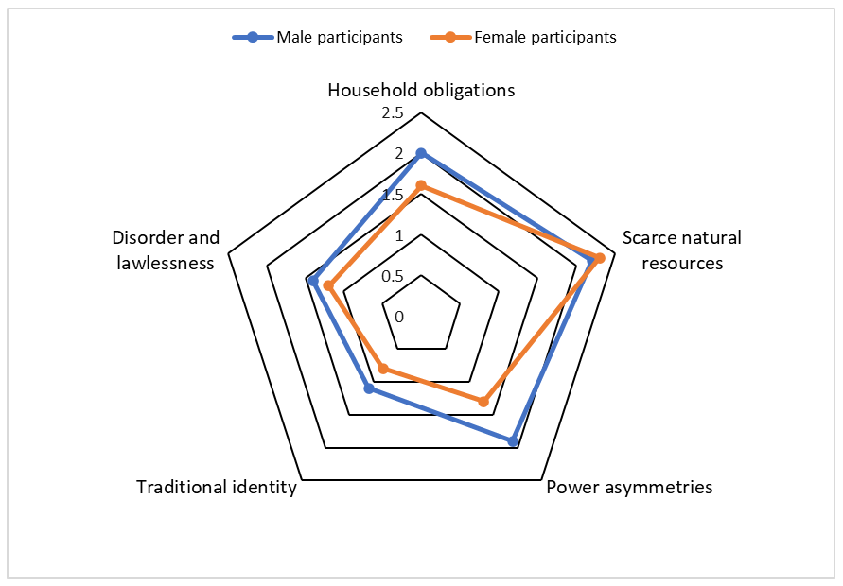
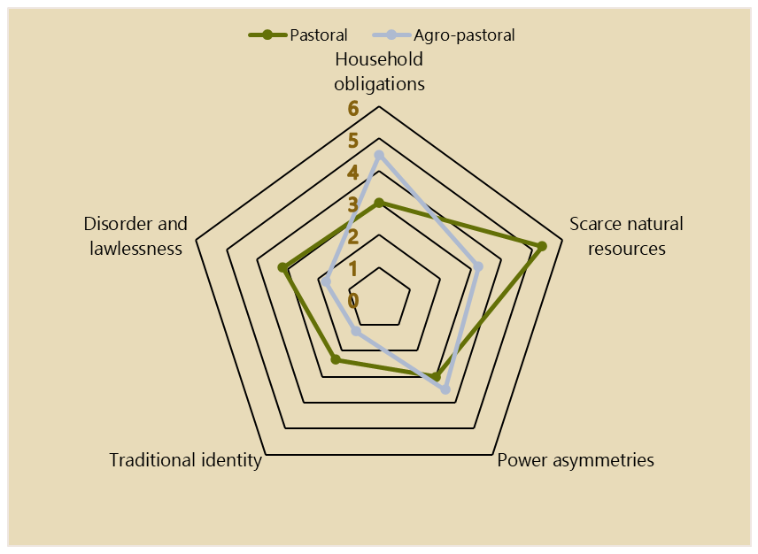
Paper 1 cont’d
Gender dimensions manifested among conflict types
Conflicts varied across agro-pastoral and pastoral areas
The manuscript was submitted & is under review in the Climate Risk Management Journal

Slide 4
DETERMINANTS OF SOCIAL
CONFLICTS IN NORTH-EASTERN UGANDA AND NORTH-WESTERN KENYA.
Research Questions
What forms of social conflicts occur at the household and community level
How do household socio-economic resources influence social conflict occurrence
Does seasonality in ecological resources influence household-level social conflicts in the study region
How does rainfall seasonality influence the forms and patterns of social conflicts?
Hypothesis
Social conflicts are mediated by household and community socio-ecological characteristics and rainfall seasonality

Slide 5
Methodology
Type of Data | Data collection method | Data analysis method | Data source
Occurrence of social conflicts & determinants | Structured interviews | Binary response model (Probit) | Baseline and follow-up survey
Forms of social conflicts & determinants | Structured interviews | Multivariate probit regression Analysis | Baseline and follow-up survey
Seasonality of social conflicts | Satellite data Structured interviews | Descriptive statistics | NASA Power satellite rainfall

Slide 6
Preliminary findings
Conflict occurrence (Male respondents) | Freq. | Percent
No | 424 | 44.92
Yes | 520 | 55.08
Total | 944 | 100
Conflicts occurrence (Female respondents) |  | Percent
No | 644 | 68.22
Yes | 300 | 31.78
Total 944 |  | 100
Types of conflicts (Male respondents)
Inter-community conflicts | Freq. | Percent
No | 598 | 63.4
Yes | 346 | 36.7
Total | 944 | 100
Intra-community conflicts | Freq. | Percent
No | 761 | 80.61
Yes | 183 | 19.39
Total | 944 | 100
Family-level conflicts | Freq. | Percent
No | 738 | 78.18
Yes | 206 | 21.82
Total | 944 | 100
Types of conflicts (Male respondents)
Intra-community conflicts | Freq. | Percent
No | 840 | 89
Yes | 104 | 11
Total | 944 | 100
Family-level conflicts | Freq. | Percent
No | 725 | 76.8
Yes | 219 | 23.2
Total | 944 | 100

Slide 7
Male vs Female
Moving from male to female-headed households, the likelihood of conflicts reduced by 0.14 units (p = 0.017**)
Moving from livestock to mixed crop and livestock-dependent HH, the likelihood of conflicts increased by 0.14 units (p = 0.10**)
Moving from HH where livestock and human migration occurred to where it didn’t, the likelihood of conflicts increased by 0.08 (p = 0.006**) and 0.11 (0.001***) units respectively
The likelihood of the conflicts reduced by 0.1 units moving from HH not originally from the area to those originally from the area (p = 0.002***)
Conflicts increased by 0.16 units moving from HH linked with excessive alcohol consumption to without (p = 0.001***)
Conflicts increased by 0.07 units in HH where men control HH income to female controlling HH income (p = 0.022**)

Slide 8
Determinants (Male respondents; 74% correctly specified )
 | dy/dx | Std. Err. z | P>z | [95% Conf. | Interval]
Country | 0.4511659 | .047406 | 9.52 | 0.000*** | 0.358252 | 0.54408
Age-set/group
36-60years | 0.0290818 | .0297454 | -0.98 | 0.328 | -0.08738 | 0.029218
Above 60years | -0.0468665 | .055613 | -0.84 | 0.399 | -0.15587 | 0.062133
HH type | -0.1435601 | .0604047 | -2.38 | 0.017** | -0.26195 | -0.02517
HH livelihood type
Crop-dependent | 0.0949931 | .0687556 | 1.38 | 0.167 | -0.03977 | 0.229752
Both crop & livestock dependent | 0.1014013 | .0563627 | 1.80 | 0.072* | -0.00907 | 0.21187
Off-farm | -0.0110023 | .0619744 | -0.18 | 0.859 | -0.13247 | 0.110465
Baseline total rainfall | 0 | (omitted)
Migration with livestock | 0.0884845 | .0324292 | 2.73 | 0.006*** | 0.024924 | 0.152045
Human migration | 0.1178177 | .0342961 | 3.44 | 0.001*** | 0.050599 | 0.185037
Wet season crop land acreage | -0.001832 | .0040136 | -0.46 | 0.648 | -0.0097 | 0.006035
Wet season livestock land acreage | 0.0021268 | .0005002 | 4.25 | 0.000*** | 0.001146 | 0.003107
Excessive alcohol consumption | 0.0408995 | .0588471 | 0.70 | 0.487 | -0.07444 | 0.156238
HH income control
Wife | -0.1081628 | .0610908 | -1.77 | 0.077* | -0.2279 | 0.011573
Both husband and wife | -0.0029773 | .0314031 | -0.09 | 0.924 | -0.06453 | 0.058572
Children/relatives | -0.123676 | .108519 | -1.14 | 0.254 | -0.33637 | 0.089017

Slide 9
Determinants (Female respondents; 70.5% correctly specified)
 | dy/dx | Std. Err. z | P>z | [95% Conf. | Interval]
Country | 0.075647 | .0558621 1.35 | 0.176 | -0.03384 | 0.185134
Age-set/group
36-60years | 0.013348 | .0306611 0.44 | 0.663 | -0.04675 | 0.073443
Above 60years | -0.0661 | .0516562 -1.28 | 0.201 | -0.16734 | 0.035144
HH type | 0.031542 | .0633972 0.50 | 0.619 | -0.09271 | 0.155798
HH livelihood type
Crop-dependent | -0.03998 | .0687669 -0.58 | 0.561 | -0.17476 | 0.094805
Both crop & livestock dependent | 0.004088 | .059718 0.07 | 0.945 | -0.11296 | 0.121133
Off-farm | 0.00075 | .065877 0.01 | 0.991 | -0.12837 | 0.129867
Baseline total rainfall | 0 | (omitted)
Family origin | -0.10623 | .0349891 -3.04 | 0.002*** | -0.1748 | -0.03765
Human migration | -0.01308 | .0349226 -0.37 | 0.708 | -0.08152 | 0.05537
Wet season crop land acreage | 0.004682 | .0043361 1.08 | 0.28 | -0.00382 | 0.013181
Wet season livestock land acreage | 0.000237 | .0002715 0.87 | 0.383 | -0.0003 | 0.000769
Excessive alcohol consumption | 0.168695 | .0528943 3.19 | 0.001*** | 0.065024 | 0.272366
Excessive alcohol consumption | 0.041813 | .0348146 1.20 | 0.23 | -0.02642 | 0.110049
HH income control
Wife | 0.060936 | .0656167 0.93 | 0.353 | -0.06767 | 0.189542
Both husband and wife | 0.074383 | .0325815 2.28 | 0.022** | 0.010524 | 0.138241
Children/relatives | 0.175137 | .1389431 1.26 | 0.207 | -0.09719 | 0.447461

Slide 10
Inter-community conflicts
 | dy/dx | Std. Err. | z | P>z | [95% Conf. | Interval]
Country | 0.081437 | .1531744 | 0.53 | 0.595 | -0.218779 | 0.381654
Baseline ppt | -0.00113 | .000246 | -4.58 | 0.000*** | -0.001608 | -0.00064
Age-set/group
36-60years | -0.03798 | .026958 | -1.41 | 0.159 | -0.090813 | 0.01486
Above 60years | -0.00955 | .0454408 | -0.21 | 0.834 | -0.098611 | 0.079514
HH type | 0.031708 | .0416112 | 0.76 | 0.446 | -0.049849 | 0.113264
2.Studysite | 0 | (not estimable)
Family origin | -0.06457 | .0308174 | -2.10 | 0.036** | -0.124973 | -0.00417
HH livelihood type
Crop-dependent | 0.091938 | .0554504 | 1.66 | 0.097* | -0.016743 | 0.200618
Both crop & livestock dependent | 0.072783 | .046832 | 1.55 | 0.12 | -0.019006 | 0.164572
Off-farm | -0.07148 | .0497033 | -1.44 | 0.15 | -0.168895 | 0.025938
Livestock migration | 0.035263 | .0290744 | 1.21 | 0.225 | -0.021722 | 0.092248
Human migration | 0.108133 | .0278543 | 3.88 | 0.000* | 0.0535396 | 0.162726
Wet season cropland acreage | 0.00082 | .0035237 | 0.23 | 0.816 | -0.006086 | 0.007726
Dry season livestock land acreage | 0.003268 | .0003559 | 9.18 | 0.000*** | 0.0025706 | 0.003966

Slide 11
Intra-community conflicts
 | dy/dx | Std. Err. | z | P>z | [95% Conf. | Interval]
Country | -0.373286 | .1303799 | -2.86 | 0.004*** | -0.6288254 | -0.11775
Baseline_ppt | -0.000913 | .0002614 | -3.49 | 0.000*** | -0.0014254 | -0.0004
Age-set/group
36-60years | 0.0133637 | .026279 | 0.51 | 0.611 | -0.0381422 | 0.06487
Above 60years | -0.056428 | .041932 | -1.35 | 0.178 | -0.1386128 | 0.025758
HH type | -0.089675 | .0425027 | -2.11 | 0.035** | -0.1729792 | -0.00637
Studysite | . | (not estimable)
B_famy_origin | 0 | (omitted)
HH livelihood type
Crop-dependent | -0.088844 | .0626189 | -1.42 | 0.156 | -0.2115744 | 0.033887
Both crop & livestock dependent | -0.0554 | .0574298 | -0.96 | 0.335 | -0.1679602 | 0.057161
Off-farm | 0.0458709 | .0660359 | 0.69 | 0.487 | -0.0835572 | 0.175299
Livestock migration | 0.0307034 | .0287388 | 1.07 | 0.285 | -0.0256236 | 0.08703
Human migration | 0.0089853 | .0304816 | 0.29 | 0.768 | -0.0507574 | 0.068728
Wet season cropland acreage | -0.000467 | .003349 | -0.14 | 0.889 | -0.0070311 | 0.006097
Dry season livestock land acreage | -0.000422 | .0002937 | -1.44 | 0.151 | -0.0009971 | 0.000154
Excessive alcohol consumption | 0.0131998 | .043467 | 0.30 | 0.761 | -0.0719939 | 0.098394

Slide 12
Family conflicts
Delta-method
 | dy/dx | Std. Err. | z | P>z | [95% Conf. | Interval]
Country | 0.6620923 | .1204708 | 5.50 | 0.000*** | 0.4259739 | 0.8982107
Baseline ppt | 0.0009923 | .0002499 | 3.97 | 0.000*** | 0.0005025 | 0.0014821
Age-set/group
36-60years | -0.0219769 | .0264234 | -0.83 | 0.406 | -0.073766 | 0.029812
Above 60years | -0.0595253 | .0417016 | -1.43 | 0.153 | -0.141259 | 0.0222085
HH type | -0.0071075 | .0556042 | -0.13 | 0.898 | -0.11609 | 0.1018746
Study site | . | (not estimable)
Family origin | 0 | (omitted)
HH livelihood type
Crop-dependent | 0.0808624 | .0509625 | 1.59 | 0.113 | -0.019022 | 0.180747
Both crop & livestock dependent | 0.1107626 | .0443757 | 2.50 | 0.013** | 0.0237879 | 0.1977373
Off-farm | 0.1612098 | .0523691 | 3.08 | 0.002*** | 0.0585683 | 0.2638514
Livestock migration | 0.0217341 | .0279548 | 0.78 | 0.437 | -0.033056 | 0.0765245
Human migration | 0.059734 | .0293302 | 2.04 | 0.042** | 0.0022479 | 0.1172201
Wet season cropland acreage | 0.0017127 | .0031309 | 0.55 | 0.584 | -0.004424 | 0.0078492
Dry season livestock land acreage | 0.0007204 | .0002776 | 2.59 | 0.009*** | 0.0001763 | 0.0012646
Excessive alcohol consumption | 0.229905 | .040816 | 5.63 | 0.000*** | 0.149907 | 0.309903
HH income control
Wife | -0.0729386 | .0495906 | -1.47 | 0.141 | -0.170134 | 0.0242572
Both husband and wife | -0.0138836 | .028374 | -0.49 | 0.625 | -0.069496 | 0.0417284
Children/relatives | -0.0564664 | .1004173 | -0.56 | 0.574 | -0.253281 | 0.1403479

Slide 13
WAY FORWARD
Date | Concept note, Provisional Admission (Change of research supervision & topic) | Proposal development; presentation to department & School | Baseline data analysis, Qualitative interviews; follow-up survey | Registration & full admission | Qualitative survey and data analysis | 1st Manuscript (Dimensionality & interconnectedness of social conflicts in Karamoja Sub-region northeastern Uganda) | 2nd Paper (Determinants of social conflicts in northeastern and northwestern Uganda) | Thesis writing | Thesis corrections and eidts, presentation at department, school, corrections | Thesis submission for examination | Viva; Thesis final edits and Final submissions
May 22- July 22
Aug 22 - March 23
Feb-June 23
July-August 23
Sept -Dec 23
Jan-24
Feb-March 24
April-June 24
July-Aug 24
Sept-Dec 24
Feb-25
March-May 25
June-Aug 25
Doctoral committee meeting between 26-27th/11/2024
Complete and submit manuscript in December/2024

